Slide 1
Predicting age from sperm methylation data
Peter Sarvari

Slide 2
Main goal
Find a model (features, their weights and regularization coefficient) to predict age from sperm methylation levels measured using the Illumina 450K array or 850K array
The model must be roboust and give realiable result no matter
Where the experiment was performed
When it was performed
What device (camera to measure light intensities) was used

Slide 3
Data information
IVF dataset
1033 samples
850K features
Aging dataset
371 samples
450K features

Slide 4
Do we need feature reduction? Our baseline results with full data
Ridge regression results with 10-fold cross-validation using all features
Mean R2 for IVF test (training): 0.752 (0.999)
Mean R2 for Aging test (training): 0.758 (0.999)
Training R2 is huge, might be overfitting
Can we make these better with feature reduction?

Slide 5
What has been done in the literature
Horvath’s Age calculator
Same idea, but uses methylation levels of different tissues and not sperm
Cited by almost 2000 people
Sperm age calculator
Jenkins et al. BMC Genomics, 2018
Uses 50 features and ridge regression
Determined based on prior knowledge and
Using a special dataset where the same individual’s methylation levels have been measured 15 years apart and choosing some of sites where the methylation level differed the most between the two measurements

Slide 6
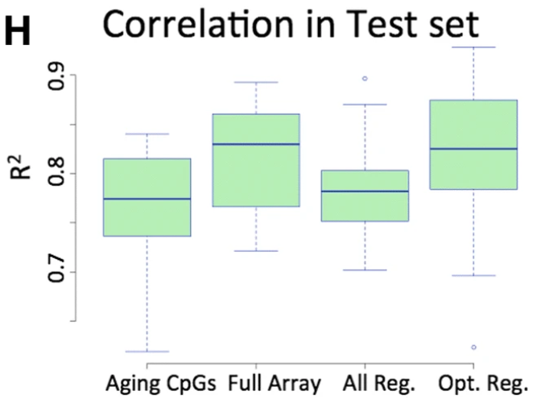
Results from Jenkins et al.
Their R2 is defined as the R2 in the linear regression analysis on Predicted age vs. Actual age
This is not the R2 that is defined as the variance explained and always yields higher values

Slide 7
Reproducing the result
Results using the 50 features and 10-fold cross-validation and slightly more samples (371 vs. 329)
R2 using the correct definition: 0.801 +/- 0.056
R2 using their definition: 0.819 +/- 0.054
So indeed, these features yield better result than using all of them (R2 improved from 0.758 to 0.801)
But what happens if we use these features on an independent dataset?

Slide 8
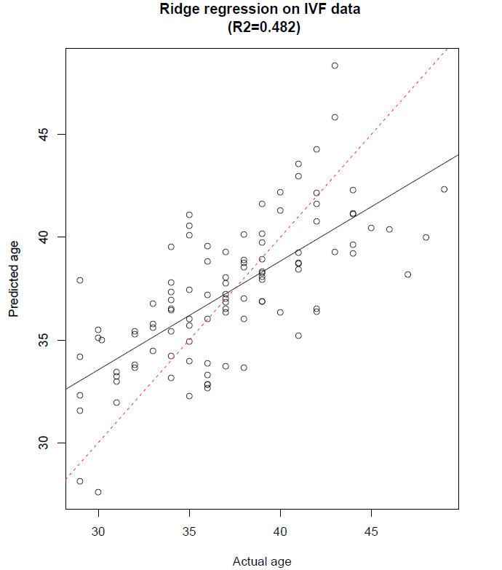
Using features from the paper on a new dataset
Let’s use their 50 features and RE-FIT a regression on new data
R2 is 0.482 far from the test R2 that they got
So these 50 features do not work well on the new (IVF) dataset
In conclusion, we need a different feature set to construct a general model

Slide 9
We use averaging in genomic intervals to reduce the features
Sperm Hypo Methylated Regions (HMR)
36506 features
Sperm HMRs overlapping promoters (regulating genes)
16285 features
Sperm HMRs *not* overlapping promoters
20221 features

Slide 10
Our features are better than those in paper: 10-fold cross-validated ridge regression on IVF data
Our features
HMR R2: 0.811 +/- 0.043
HMR and promoter intersection R2: 0.730 +/- 0.046
HMR and no promoter R2: 0.805 +/- 0.047
Paper features
R2: 0.549 +/- 0.070

Slide 11
Our features are better than those in paper: 10-fold cross-validated ridge regression on Aging data
Our features
HMR R2: 0.824 +/- 0.075
HMR and promoter intersection R2: 0.802 +/- 0.061
HMR and no promoter R2: 0.816 +/- 0.083
Paper features
R2: 0.801 +/- 0.056

Slide 12
Lasso feature reduction methods
Use Lasso for feature reduction on IVF dataset
Do 10-fold cross-validation and take union of features chosen (nonzero coefficient) in either of the folds
Use the whole data as training set in Lasso and use the features with nonzero coefficients
Then use these features on the Aging dataset (if they exist) and RE-FIT a 10-fold Lasso regression to see their predictive power

Slide 13
Retraining with chosen features: Method gives highest R2 on independent data indicating importance of Lasso feature selection
Using union of features selected in a fold
HMR
IVF data R2: 0.798 +/- 0.055
Aging data R2: 0.840 +/- 0.069
HMR and promoter intersection
IVF data R2: 0.744 +/- 0.040
Aging data R2: 0.785 +/- 0.073
HMR and not promoter
IVF data R2: 0.804 +/- 0.053
Aging data R2: 0.822 +/- 0.097

Slide 14
Retraining with chosen features: easier method yields similar results
Using selected features on the whole IVF data (no folds)
HMR
Aging data R2: 0.832 +/- 0.052
HMR and promoter intersection
Aging data R2: 0.766 +/- 0.161
HMR and not promoter
Aging data R2: 0.829 +/- 0.089

Slide 15

To acihieve our goal, we need to fix weights
Use IVF data as training set for Lasso
Use Aging data for prediction
Features, weights and regularization coefficient learnt from IVF data

Slide 16
Fixed weight method
Needed to reduce the 850K features to 450K so that the weights between IVF data and Aging data could be matched
3 methods tried
No centering
Centering of features (average methylation levels in intervals)
Centering of features and age: cheating, we take mean of „unknown” data, but shows us what happens if independent data has same mean age as training data

Slide 17
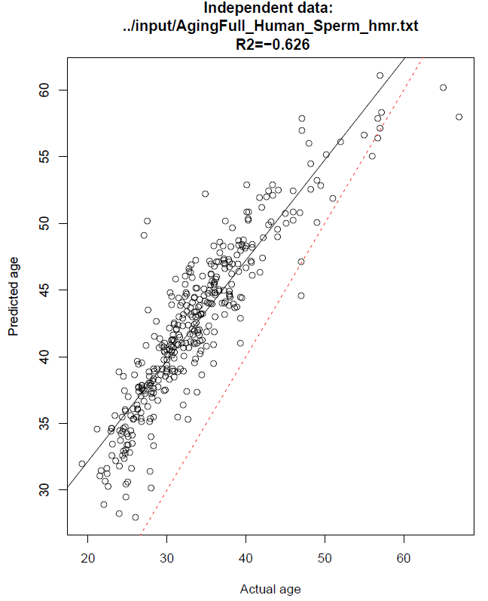
Without feature centering result is terrible
Variance explained is negative
Red dashed line is the x=y line
Black line is the linear regression of predicted age on actual age

Slide 18
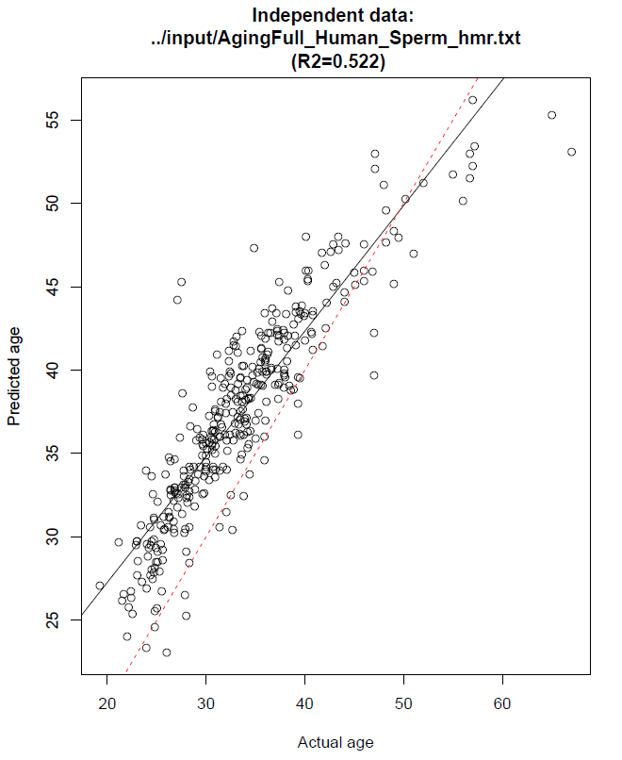
Feature centering improves result greatly
More than half of the variace is explained by the model
Predicted age seems to be on average 4 years higher than actual age
This is because the mean age in training (IVF) data is 37.38, but in the independent (Aging) data is 33.43, about 4 years higher

Slide 19
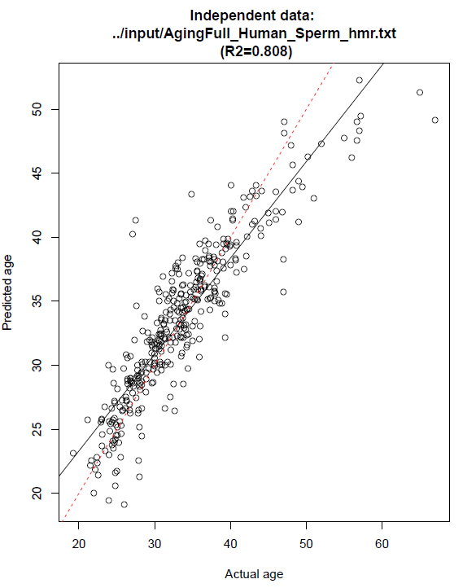
Centering on age brings red and black lines closest. This is using „unknown” data though.

Slide 20
Thoughts about the result
It is clear that if we center features, we will never get a good prediction on a new dataset if the outcome (age) averages are not similar.
This is because centering sets the average value of the features, corresponding the average outcome, to be the same, so if this is not true, we introduce bias. Indeed, all the bias seem to have disappeared once we center the outcome of both datasets around zero.
Since feature centering improved our results, we must conclude that the original bias was bigger than the one introduced by feature centering.
This bias could have arisen because of the difference between the Illumina 450K and 850K arrays, the difference between the light measuring device used in the experiments, or simply due to the geographical difference between the two cohorts in the two datasets.

Slide 21
PLS feature reduction method
„PLS is popular in the field of chemometrics, where many variables arise from digitalized spectrometry signals”
Train PLS on IVF data and use cross-validation to choose the number of components that minimize RMSE
Then predict on Aging data using this optimal number of components

Slide 22
PLS with big data
Plsr function takes formula (Age ~ .) only which causes additional overhead, resulting in stack overflow very quickly
With 1033 samples, 16285 features and 100 components plsr termminated with stack overflow
With 25 components it executes, but it terminates with stack overflow on 36506 features
So we needed to custom write the plsr function using simpls.fit directly as suggested in the original paper to reduce overhead (Mevik et al, 2007)

Slide 23
PLS results on independent (Aging) data
HMR and promoter intersection
R2: 0.748
HMR
R2: 0.644
HMR and not promoter
R2: 0.542

Slide 24
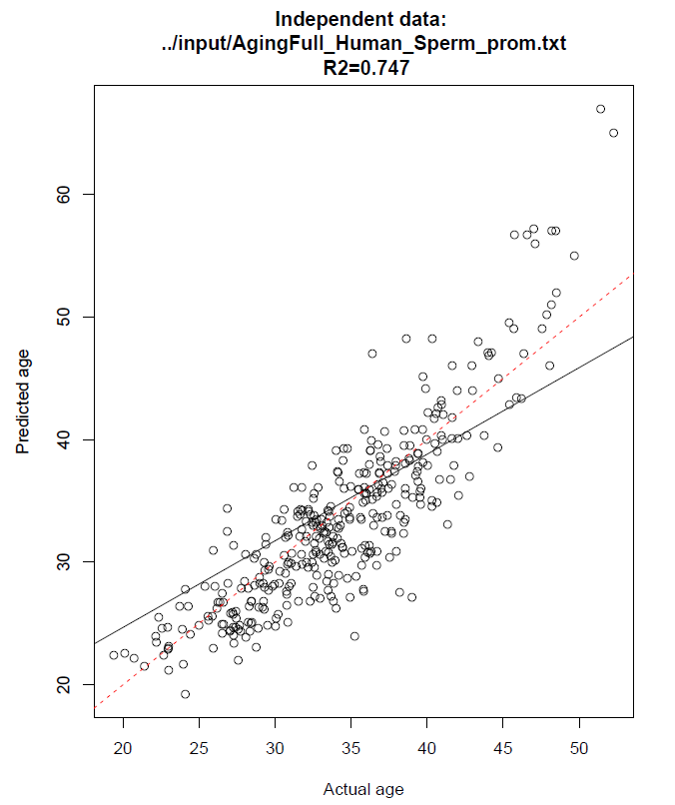
HMR and promoter intersection

Slide 25
Which method is best to achieve our goal?
HMR and promoter intersection
Lasso R2: 0.329
Lasso and feature centering R2: 0.470
PLS R2: 0.748
HMR
Lasso R2: -0.626
Lasso and feature centering R2: 0.522
PLS R2: 0.644
HMR and no promoter
Lasso R2: -0.704
Lasso and feature centering R2: 0.512
PLS R2: 0.542

Slide 26
How come PLS performs this well?
Maybe while making components uncorrelated, it gets rid of the constant bias in methylation levels
1
Maybe there is no constant bias and glmnet was just overfitting or not finding the right features
2
PLS chose only 20 components, whereas Lasso had 550 nonzero coefficients
3

Slide 27
Normalization to boost accuracy in Lasso
SWAN normalization is a method that corrects for the use of different DNA methylations arrays
This is highly relevant here, since our Aging data consists of different batches processed at different times and hence possibly run on different versions of the Illumina 450K array
Indeed, Lasso trained on the IVF data and evaluated on the Aging data chose 589 features and yielded a remarkable 83% variance explained

Slide 28
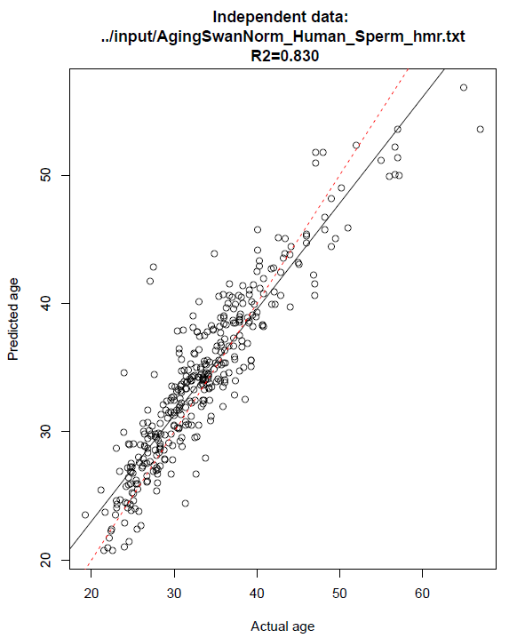
SWAN normalized Lasso result on independent dataset

